Slide 1
Welcome to:
"Navigating the Wild West of Audiobook Production"
With
Faith L. Justice

Slide 2
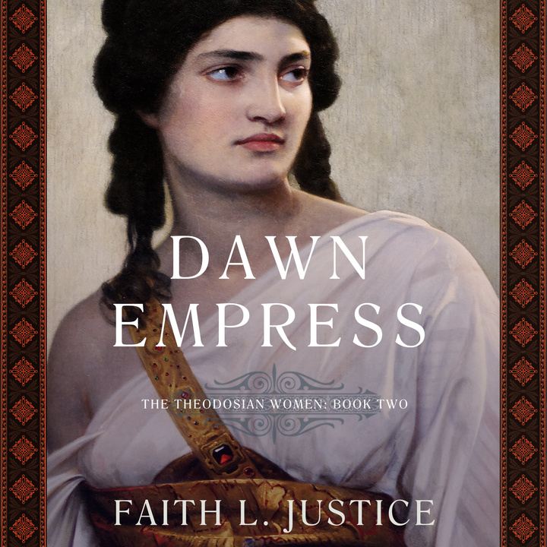
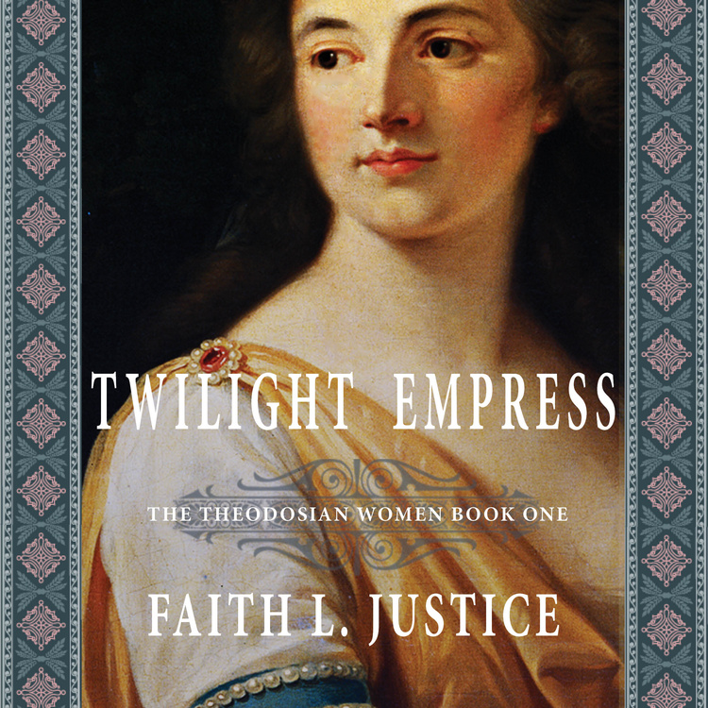
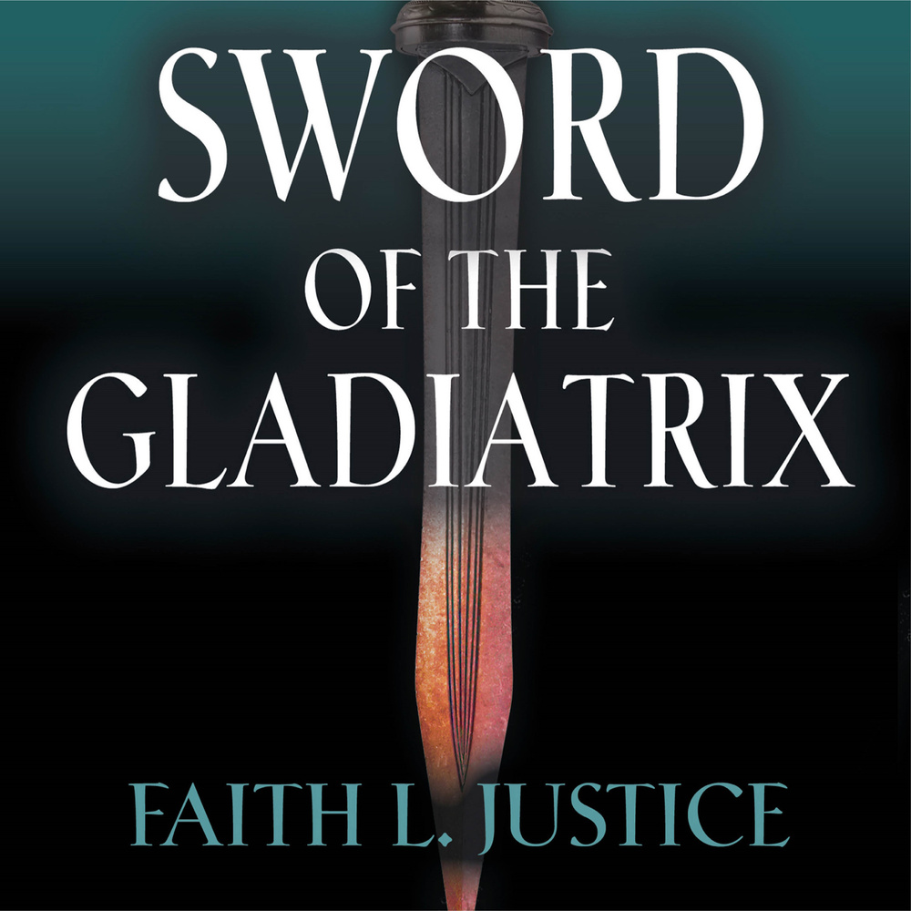
A little about me:
Published in audio:
3 collections of short stories

Slide 3
A little about me:
Published in audio:
3 collections of short stories
1 illustrated children’s book

Slide 4
A little about me:
Published in audio:
3 collections of short stories
1 illustrated children’s book
4 novels

Slide 5
A little about me:
Published in audio:
3 collections of short stories
1 illustrated children’s book
4 novels
Background in audio production

Slide 6
Purpose:
To give you enough information to decide IF and HOW to get your books into audio.
Like most things, it’s your time or your money.

Slide 7
Why be in the market?
We’ll cover:

Slide 8
Why be in the market?
Process of creating an audiobook.
We’ll cover:

Slide 9
Why be in the market?
Process of creating an audiobook.
Different routes to the market and author responsibilities in each.
We’ll cover:

Slide 10
Why be in the market?
Process of creating an audiobook.
Different routes to the market and author responsibilities in each.
We’ll cover:
Factors to consider when deciding which route to take.

Slide 11
Why be in the market?
Process of creating an audiobook.
Different routes to the market and author responsibilities in each.
We’ll cover:
Factors to consider when deciding which route to take.
Distribution channels.

Slide 12
Why be in the market?
Process of creating an audiobook.
Different routes to the market and author responsibilities in each.
We’ll cover:
Factors to consider when deciding which route to take.
Distribution channels.
Market trends/strategies.

Slide 13
Why be in the market?
Process of creating an audiobook.
Different routes to the market and author responsibilities in each.
We’ll cover:
Factors to consider when deciding which route to take.
Distribution channels.
Market trends/strategies.
Q & A at the end.

Slide 14
Why should you get in the audio-book market?
For the readers:
They can find you in their preferred medium.

Slide 15
Why should you get in the audio-book market?
For the readers:
They can find you in their preferred medium.
For the money:
This is the fastest-growing segment of the publishing business.

Slide 16
Why should you get in the audio-book market?
Why now rather than later?
For the readers:
They can find you in their preferred medium.
For the money:
This is the fastest-growing segment of the publishing business.

Slide 17
Why should you get in the audio-book market?
Why now rather than later?
For the readers:
They can find you in their preferred medium.
For the money:
This is the fastest-growing segment of the publishing business.
To beat the competition:
The big guys smell the money and they're ramping up.

Slide 18
Audiobook Readers:
Are new readers - prefer audio to print/ eBooks and consume 8.1 books per year.

Slide 19
Audiobook Readers:
Are new readers - prefer audio to print/ eBooks and consume 8.1 books per year.
Make new time to listen beyond their sight reading.

Slide 20
Audiobook Readers:
Are new readers - prefer audio to print/ eBooks and consume 8.1 books per year.
Make new time to listen beyond their sight reading.
Are young, educated & employed - 57% of frequent listeners are aged 18-44.

Slide 21
Audiobook Market
125
Fastest-growing segment in publishing with double-digit growth the past 8 years and the same projected through 2027.
100
75
50
25
0
Item 1
Item 2
Item 3
Item 4
Item 5

Slide 22
Audiobook Market
125
Fastest-growing segment in publishing with double-digit growth the past 8 years and the same projected through 2027.
Revenues of $1.2 billion for audiobooks surpassed revenues for eBooks in 2019.
100
75
50
25
0
Item 1
Item 2
Item 3
Item 4
Item 5

Slide 23
Audiobook Market
125
Fastest-growing segment in publishing with double-digit growth the past 8 years and the same projected through 2027.
Revenues of $1.2 billion for audiobooks surpassed revenues for eBooks in 2019.
13.7% of book sales in the US market.
100
75
50
25
0
Item 1
Item 2
Item 3
Item 4
Item 5

Slide 24
Audiobook Market
125
Fastest-growing segment in publishing with double-digit growth the past 8 years and the same projected through 2027.
Revenues of $1.2 billion for audiobooks surpassed revenues for eBooks in 2019.
13.7% of book sales in the US market.
Fiction is 67% of the audio market vs. 40% in print.
100
75
50
25
0
Item 1
Item 2
Item 3
Item 4
Item 5

Slide 25
Why now?
50
Competition low / Discoverability high
1.7 million books in print and eBook
40
30
20
10
0
Item 1
Item 2
Item 3
Item 4
Item 5

Slide 26
Why now?
50
Competition low / Discoverability high
1.7 million books in print and eBook
600K books published in 2020
40
30
20
10
0
Item 1
Item 2
Item 3
Item 4
Item 5

Slide 27
Why now?
50
Competition low / Discoverability high
1.7 million books in print and eBook
600K books published in 2020
71K audiobooks published in 2020
40
30
20
10
0
Item 1
Item 2
Item 3
Item 4
Item 5

Slide 28
Why now?
50
Competition low / Discoverability high
1.7 million books in print and eBook
600K books published in 2020
71K audiobooks published in 2020
50K HF titles listed in the Kindle Store
40
30
20
10
0
Item 1
Item 2
Item 3
Item 4
Item 5

Slide 29
Why now?
50
Competition low / Discoverability high
1.7 million books in print and eBook
600K books published in 2020
71K audiobooks published in 2020
50K HF titles listed in the Kindle Store
10K HF titles listed in Audible
40
30
20
10
0
But it won't stay that way!
Item 1
Item 2
Item 3
Item 4
Item 5

Slide 30
Commute vs. Home
Market Trends
Item 5
20%
Item 1
20%
Item 4
20%
Item 2
20%
Item 3
20%

Slide 31
Commute vs. Home
Market Trends
Phone vs. Smart speaker
Item 5
20%
Item 1
20%
Item 4
20%
Item 2
20%
Item 3
20%

Slide 32
Commute vs. Home
Market Trends
Phone vs. Smart speaker
Item 5
20%
Item 1
20%
Item 4
20%
Item 2
20%
1-buy download vs. Monthly subscription
Item 3
20%

Slide 33
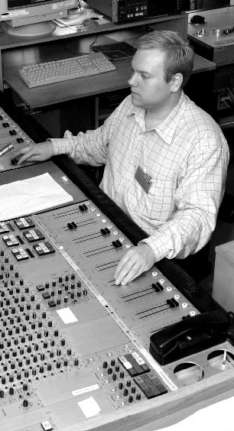
What's keeping you from jumping in?

Slide 34
What's keeping you from jumping in?
Money?

Slide 35
What's keeping you from jumping in?
Money?
Technical know-how?

Slide 36
The Journey from Print to Audio
Who owns rights to audio production

Slide 37
The Journey from Print to Audio
Who owns rights to audio production
Who will produce

Slide 38
The Journey from Print to Audio
Who owns rights to audio production
Who will produce
Prep manuscript

Slide 39
The Journey from Print to Audio
Who owns rights to audio production
Who will produce
Prep manuscript
Record

Slide 40
The Journey from Print to Audio
Who owns rights to audio production
Who will produce
Prep manuscript
Record
Edit

Slide 41
The Journey from Print to Audio
Who owns rights to audio production
Who will produce
Prep manuscript
Record
Edit
Quality Control

Slide 42
The Journey from Print to Audio
Who owns rights to audio production
Who will produce
Prep manuscript
Record
Edit
Quality Control
Retakes

Slide 43
The Journey from Print to Audio
Who owns rights to audio production
Who will produce
Prep manuscript
Record
Edit
Quality Control
Retakes
Remastering

Slide 44
The Journey from Print to Audio
Who owns rights to audio production
Who will produce
Prep manuscript
Record
Edit
Quality Control
Retakes
Remastering
Submit files to distributors (with audio cover)

Slide 45
4 Routes to Market
Assign rights to an audiobook publisher

Slide 46
Assign rights
Pros:
Least involvement
No upfront $
Professional
Prestige

Slide 47
Assign rights
Pros:
Cons:
Least involvement
No upfront $
Professional
Prestige
Hardest to get w/wo agent
Least control
Low royalties

Slide 48
4 Routes to Market
Assign rights to an audiobook publisher
Hire full-service audio production company

Slide 49
Assign rights
Pros:
Cons:
Least involvement
No upfront $
Professional
Prestige
Hardest to get w/wo agent
Least control
Low royalties
Hire full service
Pros:
Less work
More control
Professional

Slide 50
Assign rights
Pros:
Cons:
Least involvement
No upfront $
Professional
Prestige
Hardest to get w/wo agent
Least control
Low royalties
Hire full service
Pros:
Cons:
Less work
More control
Professional
Most expensive

Slide 51
4 Routes to Market
Assign rights to an audiobook publisher
Hire full-service audio production company
Author DIY

Slide 52
Author DIY:
Pros:
Cheapest option
Free DIY resources
Complete control

Slide 53
Author DIY:
Pros:
Cons:
Cheapest option
Free DIY resources
Complete control
Readers prefer professional narrator
Learning curve tech
Time

Slide 54
4 Routes to Market
Assign rights to an audiobook publisher
Hire full-service audio production company
Author produces, outsources all/some tasks
Author DIY

Slide 55
Author DIY:
Pros:
Cons:
Cheapest option
Free DIY resources
Complete control
Readers prefer professional narrator
Learning curve tech
Time
Author outsources:
Pros:
Cheaper than full service
Others do tech stuff
Professional voice
Considerable control

Slide 56
Author DIY:
Pros:
Cons:
Cheapest option
Free DIY resources
Complete control
Readers prefer professional narrator
Learning curve tech
Time
Author outsources:
Pros:
Cons:
Cheaper than full service
Others do tech stuff
Professional voice
Considerable control
More expensive than DIY
Learning curve platform
Time

Slide 57
Author Outsource Options:
Author
Prep manuscript
Audition/select narrator
Quality Control*
Choose channels/Distribute files
Set price/Marketing

Slide 58
Author Outsource Options:
Author
Indie Narrator Producer
Prep manuscript
Audition/select narrator
Quality Control*
Choose channels/Distribute files
Set price/Marketing
Record
Edit
Retakes
Remastering

Slide 59
Author Outsource Options:
Author
Indie Narrator Producer
Audio services/ distribution
Prep manuscript
Audition/select narrator
Quality Control*
Choose channels/Distribute files
Set price/Marketing
Record
Edit
Retakes
Remastering
Propose narrators
Record
Edit
Retakes
Remastering
Distribute files

Slide 60
Distribution: Exclusive?
Audible only:
Pros:
higher royalties (40% vs. 25%)
single dashboard
preferred giveaway codes

Slide 61
Distribution: Exclusive?
Audible only:
Pros:
higher royalties (40% vs. 25%)
single dashboard
preferred giveaway codes
Cons:
lose out on wider market
no distribution to libraries
no price control

Slide 62
Distribution: or Not?
Non-exclusive:
Pros:
wider market including libraries
price control
giveaway codes

Slide 63
Distribution: or Not?
Non-exclusive:
Pros:
wider market including libraries
price control
giveaway codes
Cons:
lose preferred market Audible codes
multiple dashboards

Slide 64
Hire a celebrity narrator
Marketing Strategies
Item 5
20%
Item 1
20%
Item 4
20%
Item 2
20%
Item 3
20%

Slide 65
Hire a celebrity narrator
Marketing Strategies
Launch audio version with print/eBook
Item 5
20%
Item 1
20%
Item 4
20%
Item 2
20%
Item 3
20%

Slide 66
Hire a celebrity narrator
Marketing Strategies
Launch audio version with print/eBook
Giveaway codes to reviewers
Item 5
20%
Item 1
20%
Item 4
20%
Item 2
20%
Item 3
20%

Slide 67
Hire a celebrity narrator
Marketing Strategies
Launch audio version with print/eBook
Giveaway codes to reviewers
Item 5
20%
Item 1
20%
Promote your paper book
Item 4
20%
Item 2
20%
Item 3
20%

Slide 68
Hire a celebrity narrator
Marketing Strategies
Launch audio version with print/eBook
Giveaway codes to reviewers
Item 5
20%
Item 1
20%
Promote your paper book
Item 4
20%
Item 2
20%
Use price drop/Chirp
Item 3
20%

Slide 69
THANK YOU!
Email: Faith@FaithLJustice.com
Website: FaithLJustice.com
Twitter: @faithljustice
Facebook: faithljusticeauthor
Instagram: fljusticeauthor

